Slide 1
BEARCATS BOUND ORIENTATION
UTILIZING CAMPUS TOOLS AND SCHEDULING ADVISING APPOINTMENT

Slide 2
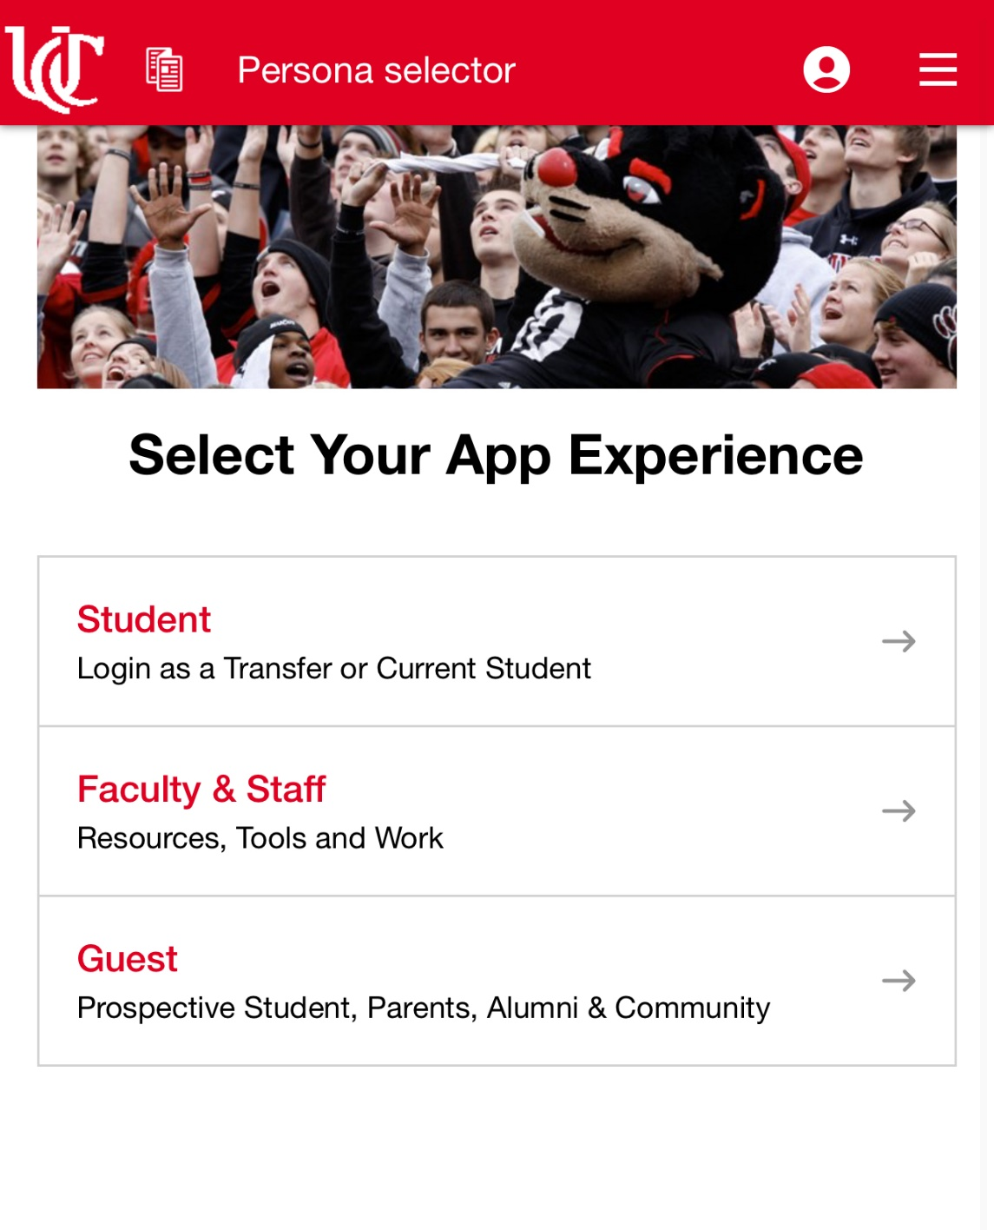
Access Your Bearcat Portal
Go to bearcatportal.uc.edu or scan the QR code below
Be sure to sign in as a student

Slide 3
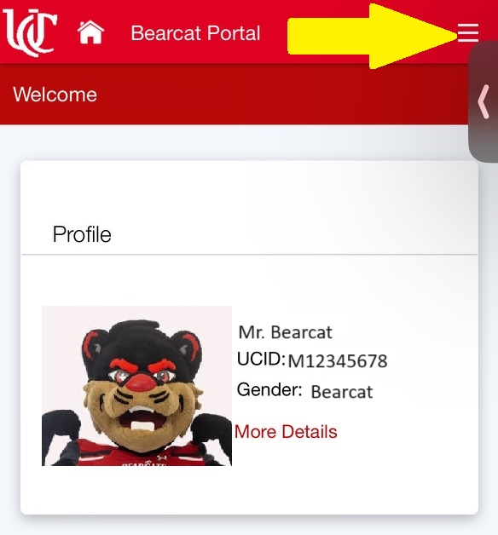
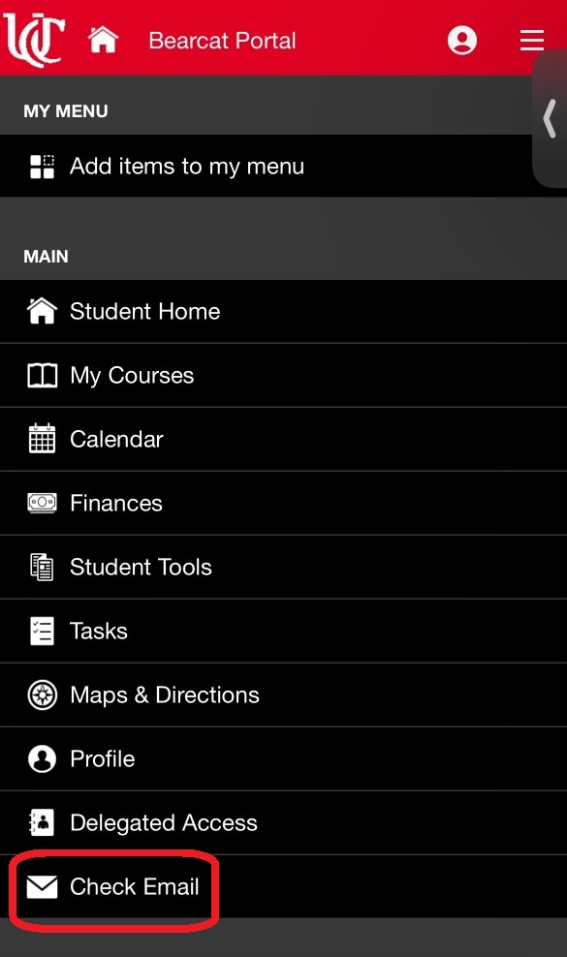
Access Your UC Email
Tap 3 horizontal lines in the top right corner
Scroll in the menu until you see “Check Email” and click the tab

Slide 4
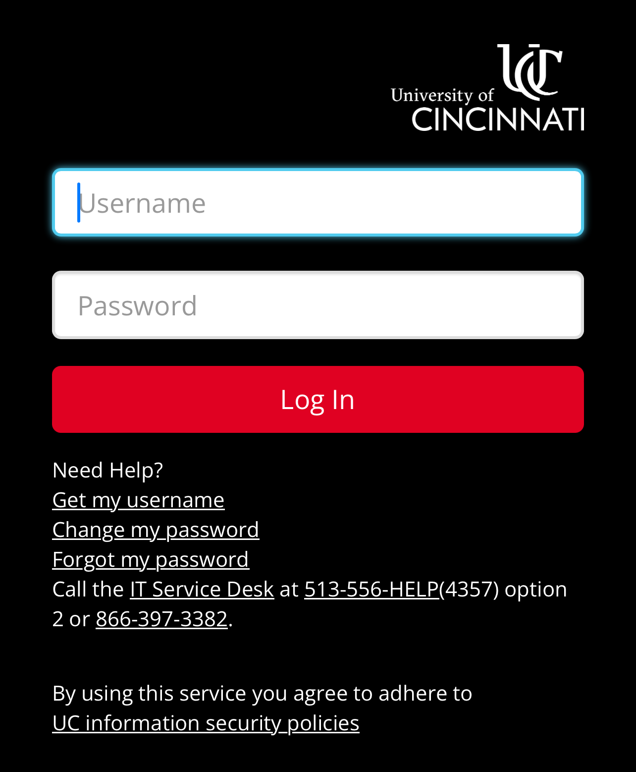
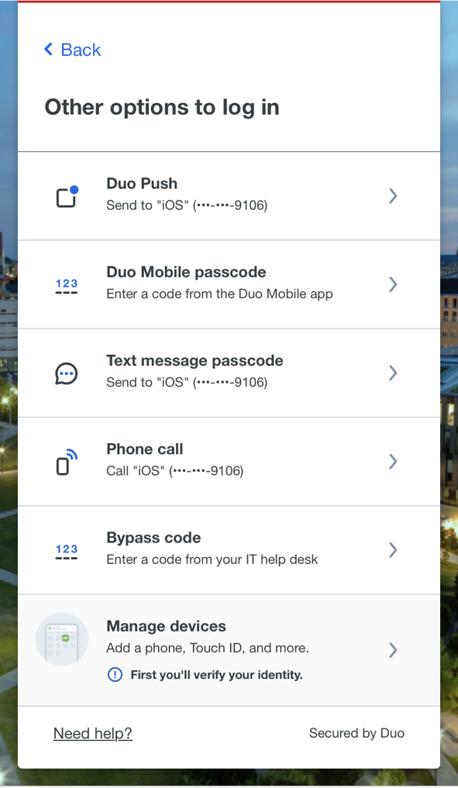
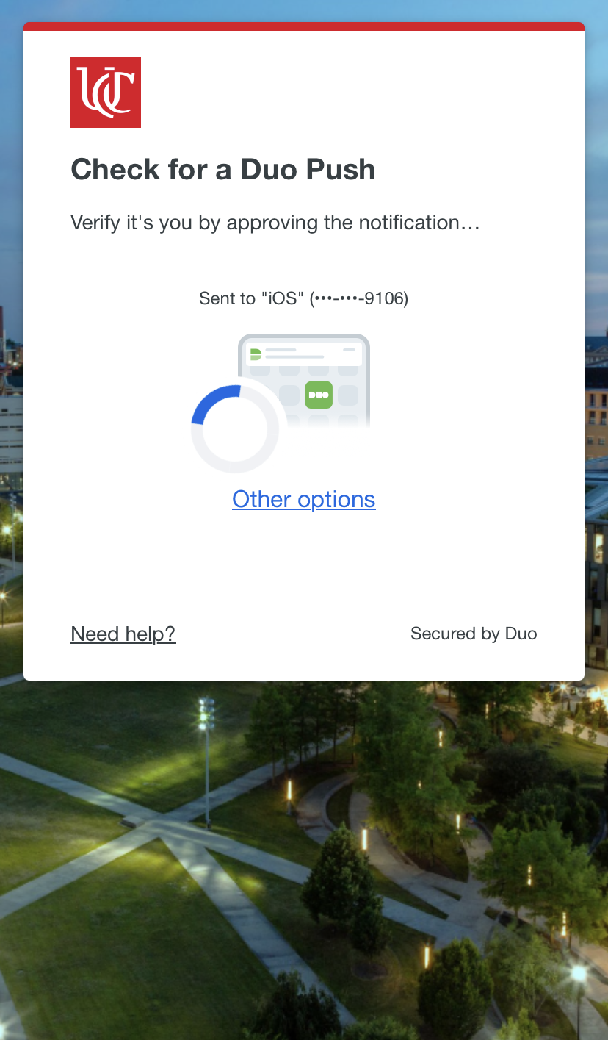
Access Your UC Email
Sign in using your UC username and password
Same login information you use for your Bearcat Portal
Accept Duo Verification (push notification, phone call, text message)

Slide 5
Access Canvas
Scan QR code below or visit uc.instructure.com
Sign in with same information as Bearcat Portal
Similar sign in process as before
Download Canvas on your phone to easily access your classes and assignments

Slide 6
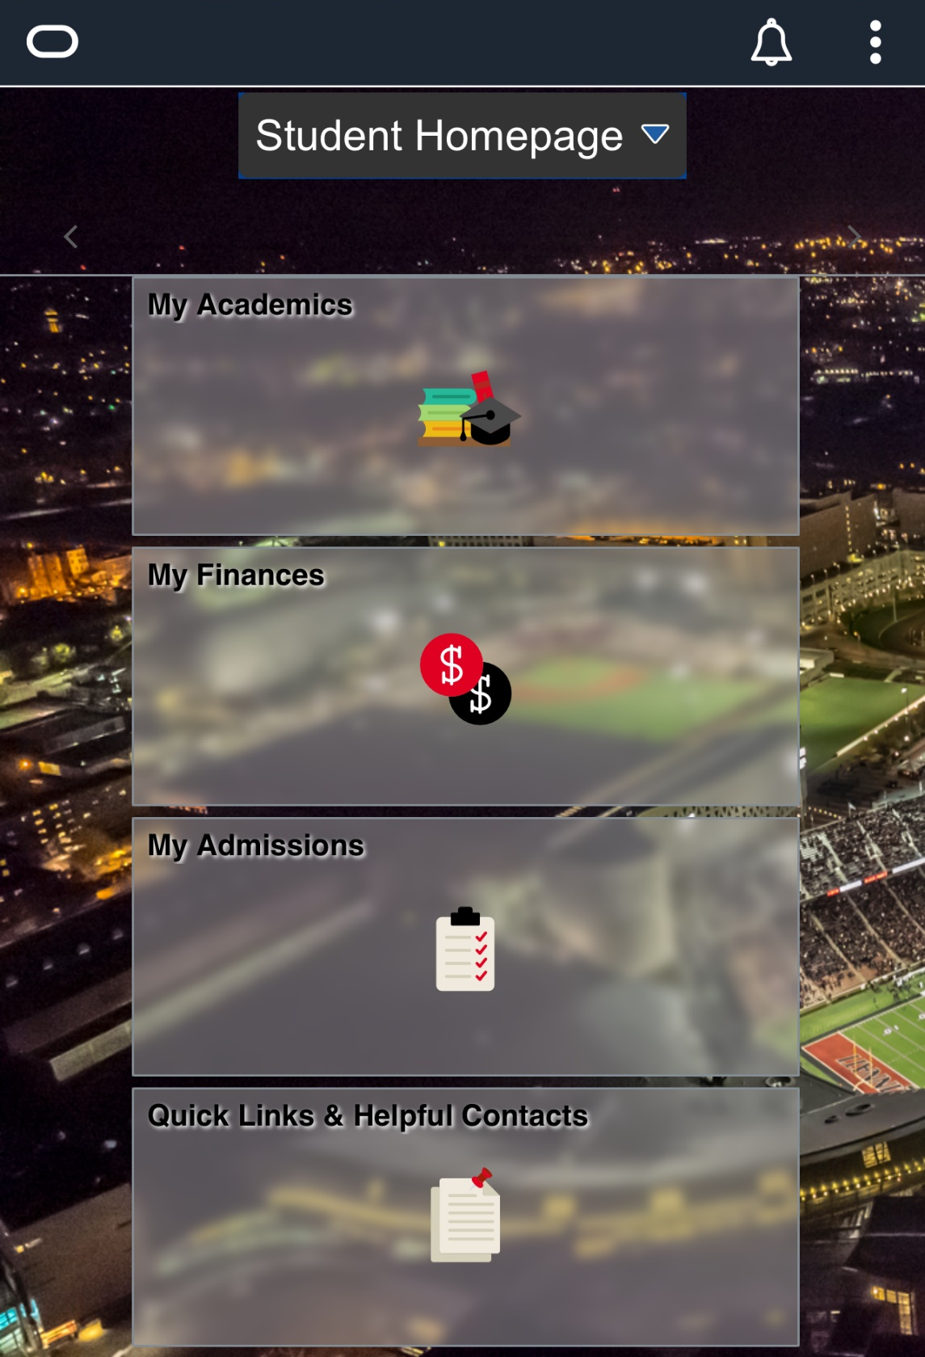
Access Catalyst
Visit catalyst.uc.edu or scan QR code below
Same sign in process as before
View tuition bill in “Finances” tile
View class schedule in “Academics” tile
Search & apply for scholarships under “Scholarship Search” tile

Slide 7
Access My Bearcat Network
Scan the QR code below to login to My Bearcat Network
Click “Login with NETID” and use same username and password as your Bearcat Portal

Slide 8
Schedule Advising Appointment
Click “Contact My Advisor” underneath the “Connect” section
Select the “Schedule Appointment” next to your assigned advisor

Slide 9
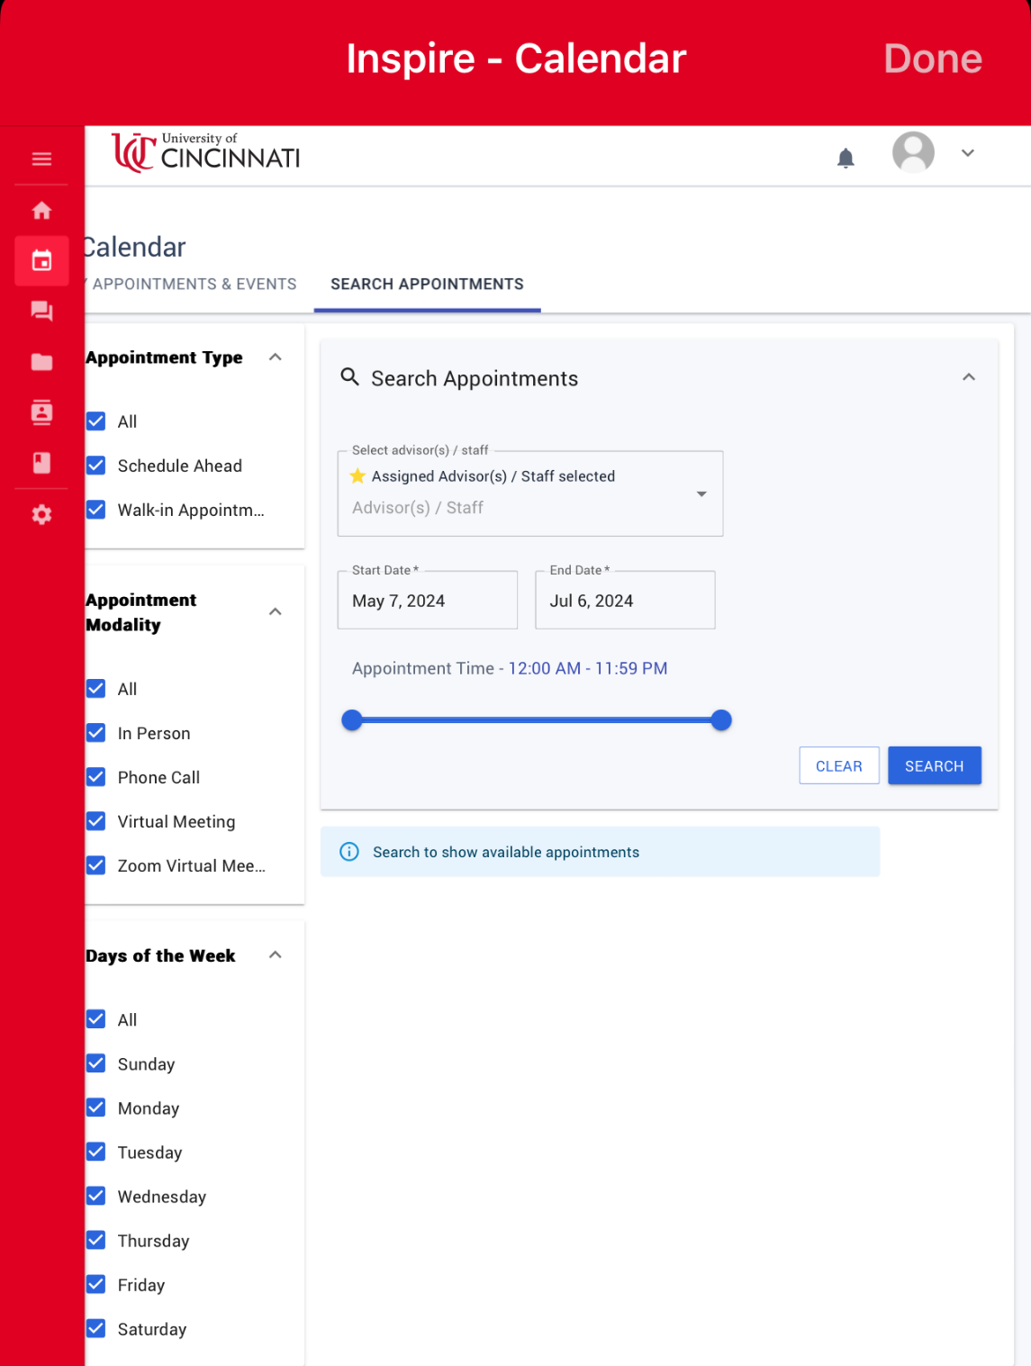
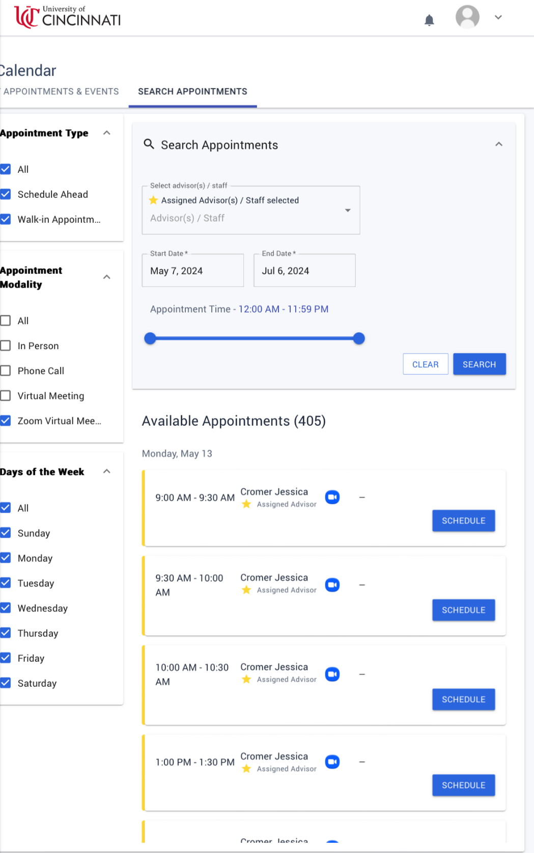
Schedule Advising Appointment
Under “Appointment Modality” select “Zoom Virtual Meeting” option
You can filter appointment availability by date
Select a day and time that works best for you

Slide 10
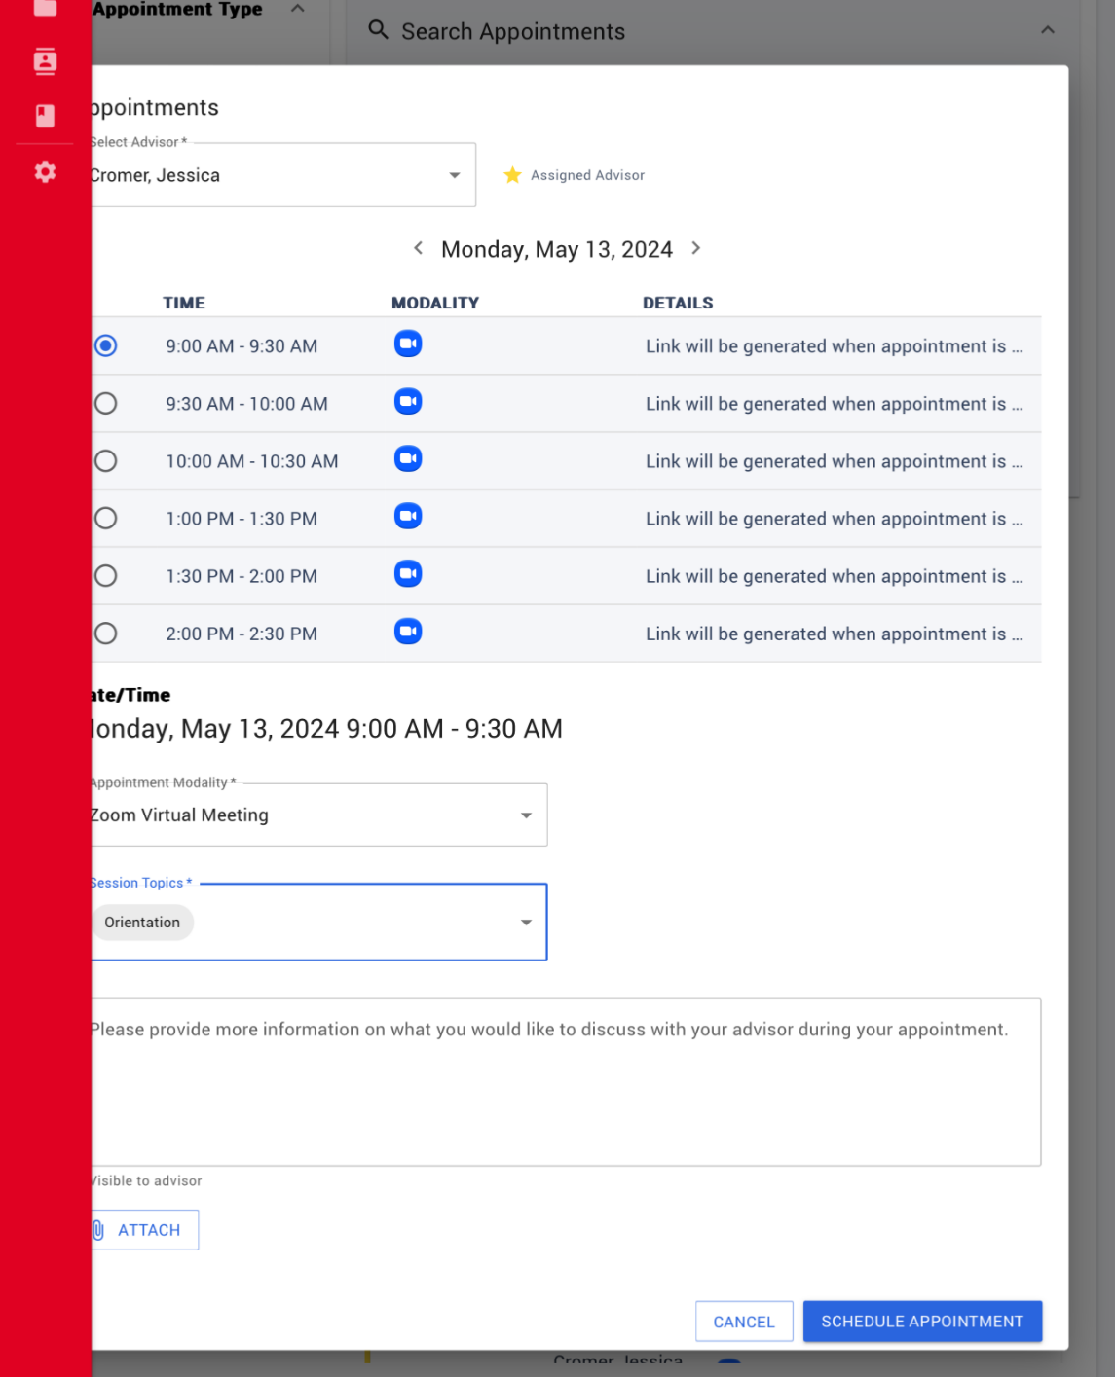
Schedule Advising Appointment
Once you have an appointment selected, confirm the date and time
Under the drop-down “Session Topics”, select “Orientation”
Finish scheduling by clicking “Schedule Appointment”
You will receive a confirmation email to your UC email account that includes the link to join the meeting

