Slide 1

hi
BEARCATS BOUND ORIENTATION
UC 101
Uc 1001 by kasey drennen

Slide 2
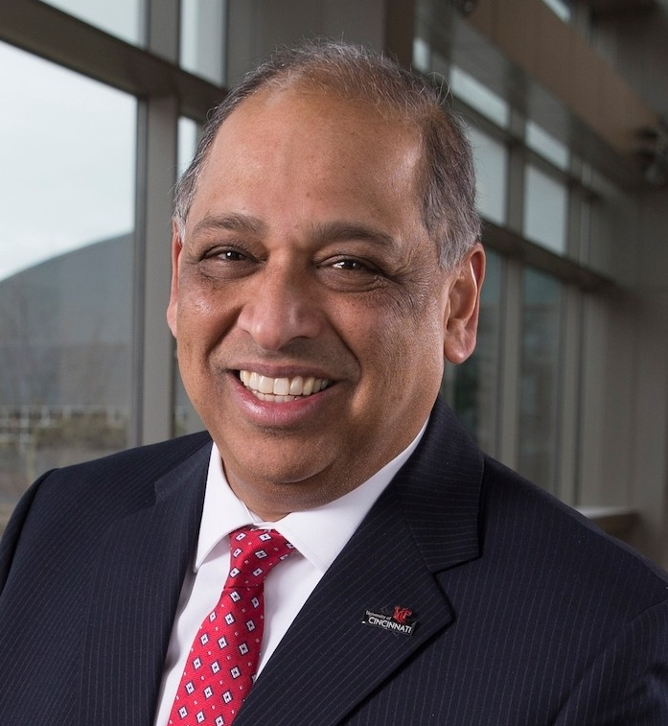
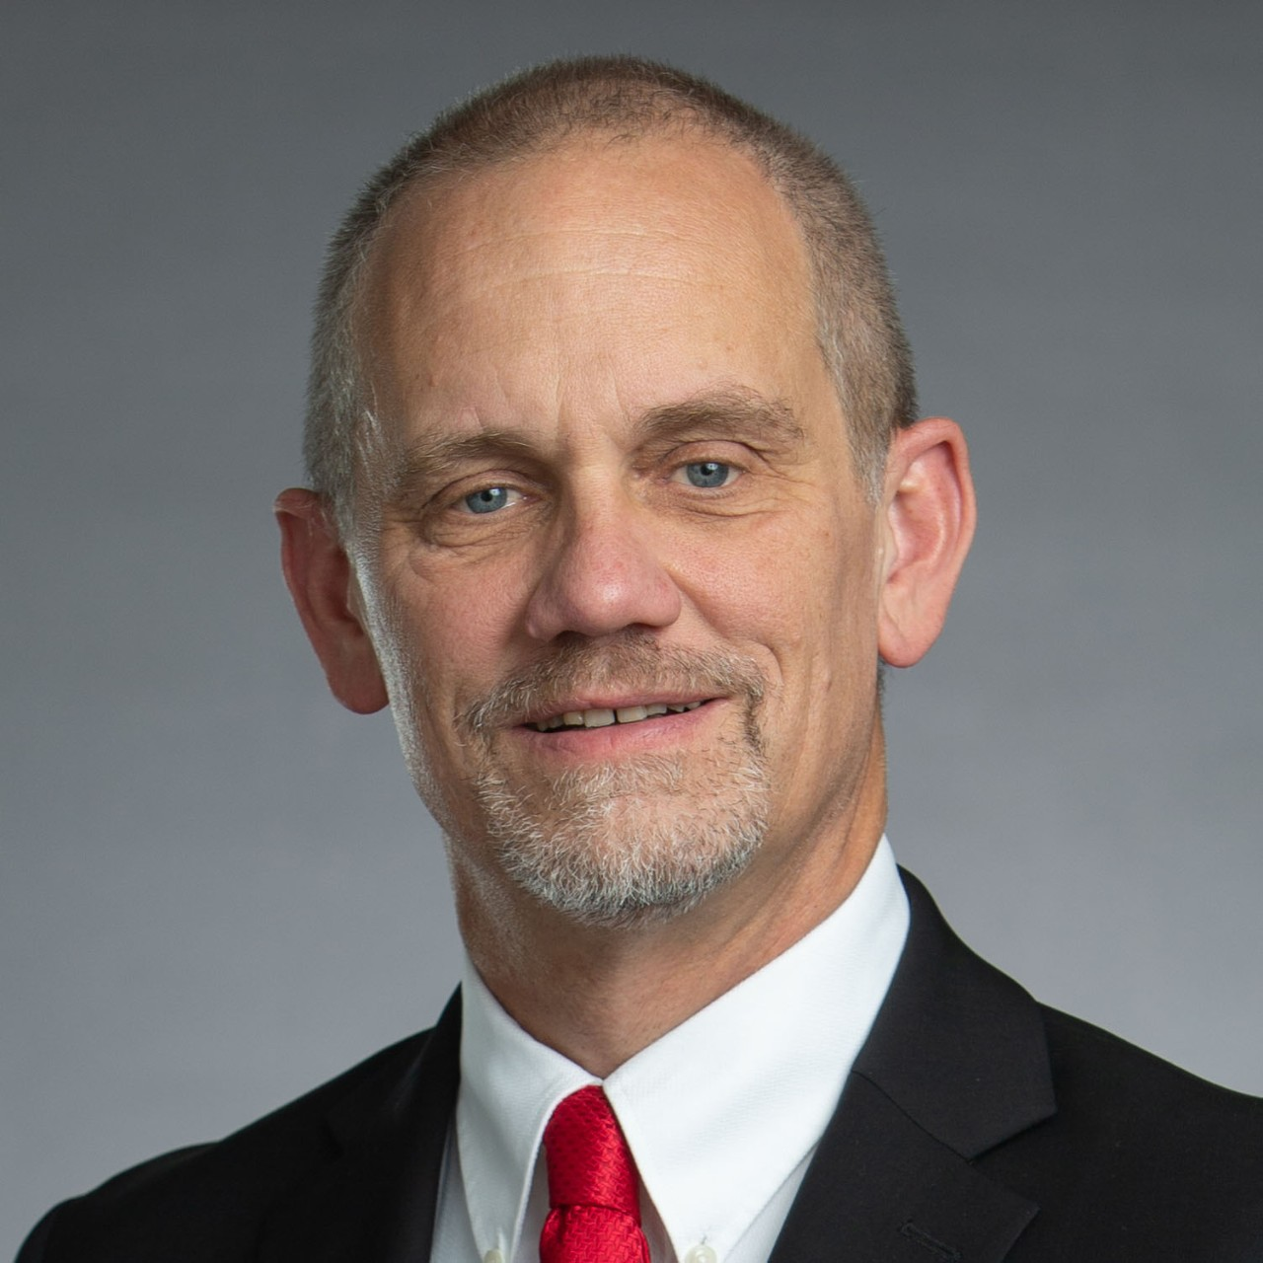
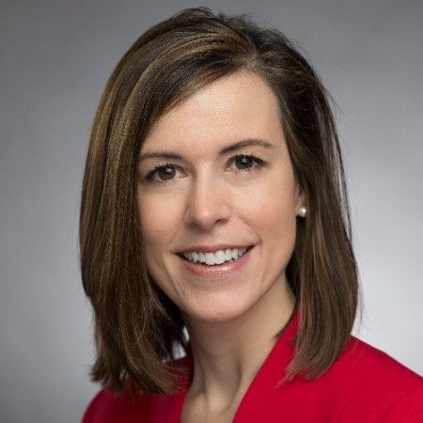

Key Leaders At UC
Neville G. Pinto, PhD
President
Valerio Ferme, PhD
Executive Vice President
and Provost
Nicole Mayo, EdD
Vice President
For Student Affairs

Slide 3
Colleges at UC
College Conservatory of Music
CCM
College of Allied Health Sciences CAHS
College of Arts & Sciences
A&S
Lindner College of Business
LCB
College of Education, Criminal Justice & Human Services & IT
CECH
College of Design, Architecture, Art, & Planning
DAAP
College of Engineering & Applied Science
CEAS
College of Medicine
COM
College of Nursing
CON
Notes:
9 undergrad colleges under the UC umbrella

Slide 4
Academic Credit Hours
“A credit hour is an amount of work represented in intended learning outcomes and verified by evidence of student achievement”
Classes range from 1 to 6 credits each
Full Time Student
12 to 18 Credit Hours
Part Time Students
1 to 11 Credit Hours

Slide 5
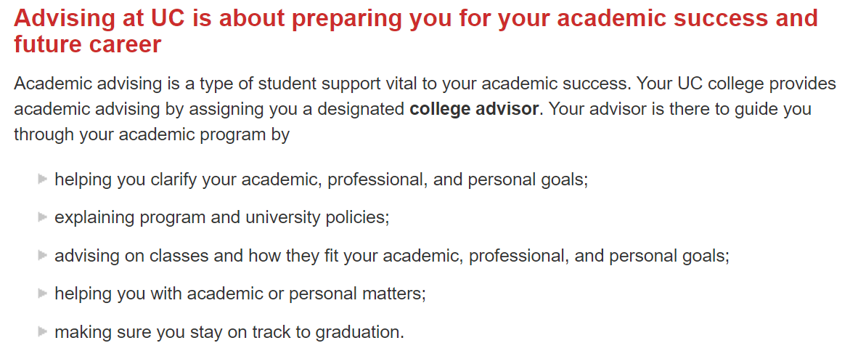
Academic Advising at UC

Slide 6

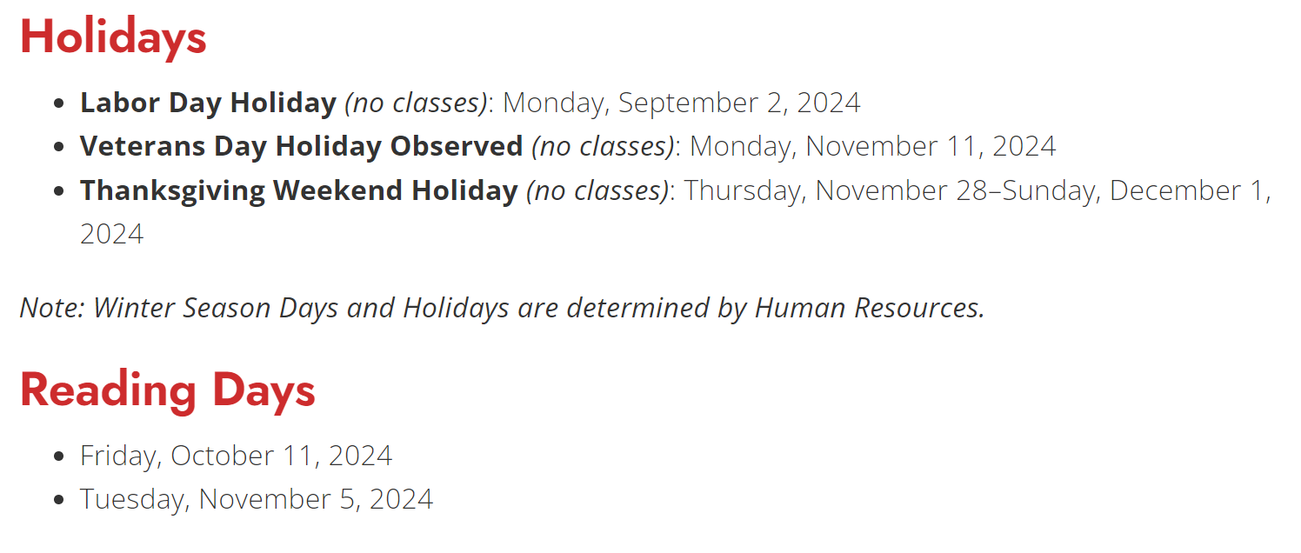
Academic Calendar Fall 2024
Fall Semester 2024 Term Dates:
August 26–December 14, 2024

Slide 7



Paying Tuition at UC
Online: eCheck/ACH or Credit Card
By Mail (Cleveland Address)
College Savings Plan
  529 Savings Plan
Semester Payment Plan
  Divide tuition in three equal payments
Enrollment Services : enrollmentservices@uc.edu
513-556-1000

Slide 8
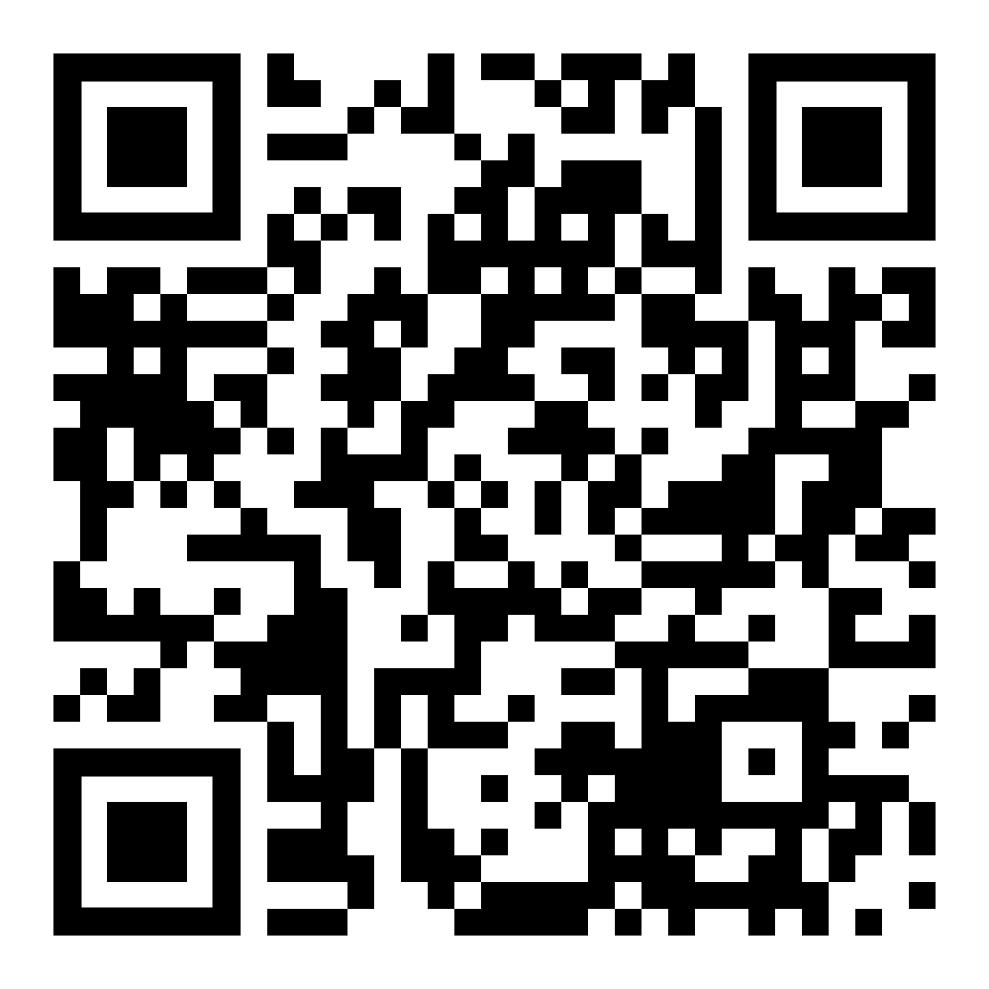
What is FERPA?
The Family Education Rights and Privacy Act of 1974
Federal law that governs the release of and access to student education records.
UC utilizes a Delegated Access process for students to grant access to specific types of information within the Catalyst student portal.
For more info:

Slide 9








Some Student Tools
Catalyst
Bearcat Portal
& UC Mobile
Outlook Email
MS Teams
Handshake
Duo Mobile

Slide 10
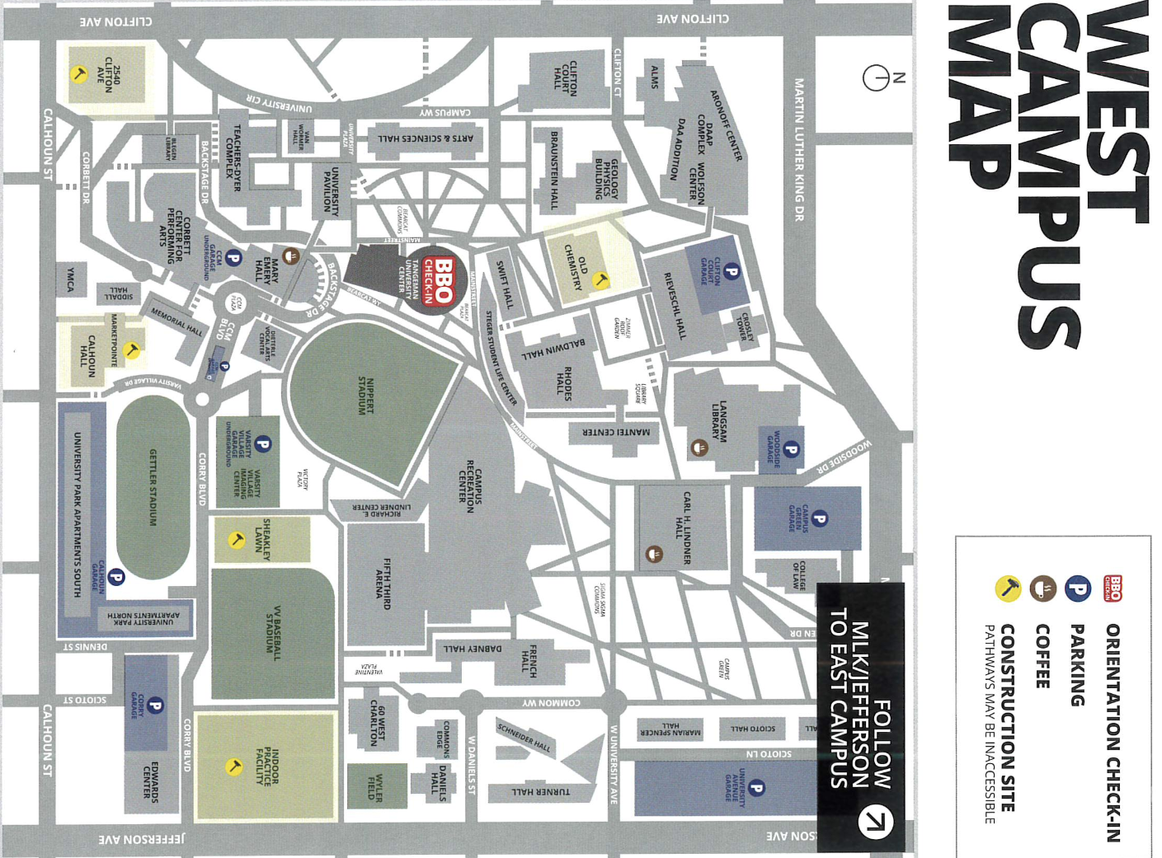
Navigating UC’s Campus

Slide 11
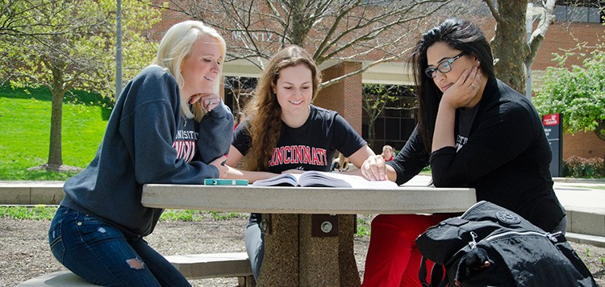
Student Resources On Campus
Accessibility Resources
At UC, we are committed every day to providing full and equal access to students, employees and visitors with disabilities; and promoting self-advocacy to students.

Slide 12


Student Resources On Campus
University Health Services
University Health Services offers comprehensive clinical services to students enrolled at the university.

Slide 13
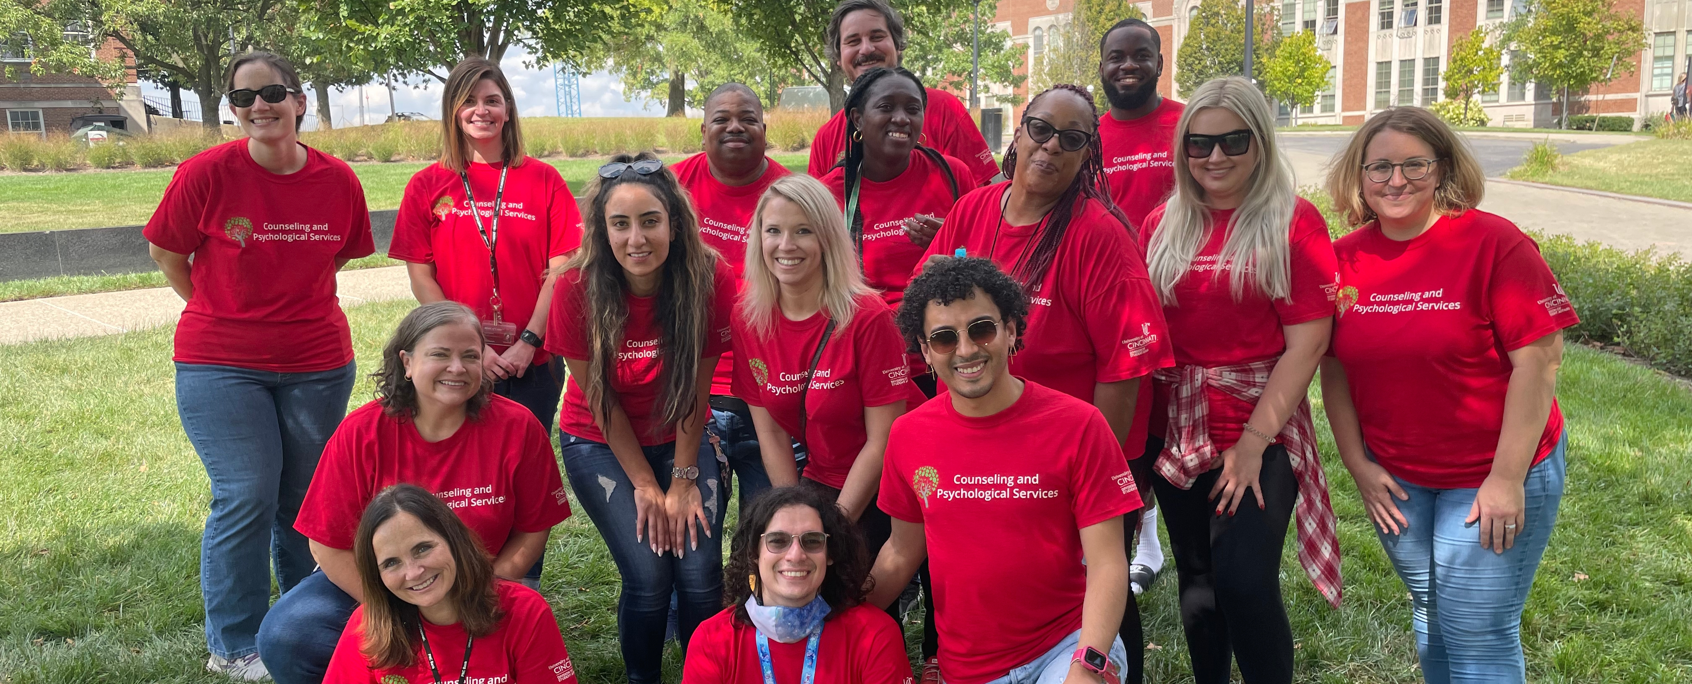
Student Resources On Campus
Counselling and Psychological Services (CAPS)
At UC CAPS, we prioritize accessible, effective services, offering collaborative, strengths-based support to help you reach your mental health goals.

Slide 14
Student Safety On Campus
UC Public Safety and the City of Cincinnati work hand in hand to provide safety resources to students such as:
24/7 Campus Patrol
  UC Police and security officers
NightRide Shuttle
  Safe and free night-time shuttle for Bearcat ID holders
Bearcat Guardian App
  Safety app with various features and documents
280+ blue help phones
  Strategically places around campus for emergency and
  non-emergency needs

Slide 15

BEARCATS BOUND ORIENTATION
BREAK

