Slide 2
Program Types

Slide 3
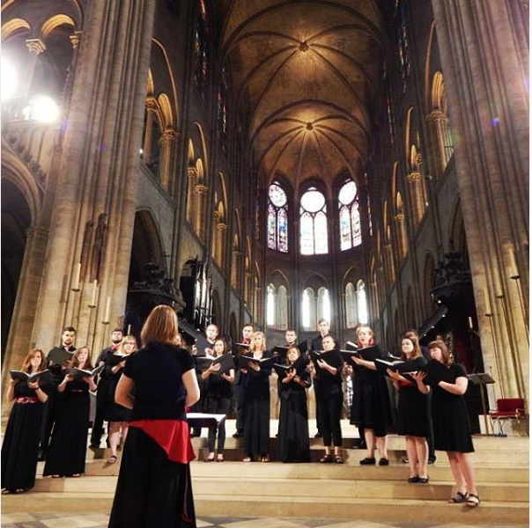
FACULTY-LED PROGRAMS
Short spring break, winter break, and summer programs
1-3 weeks
Led by UC Professors
Many attached to a course on campus
CCM Students, France

Slide 4
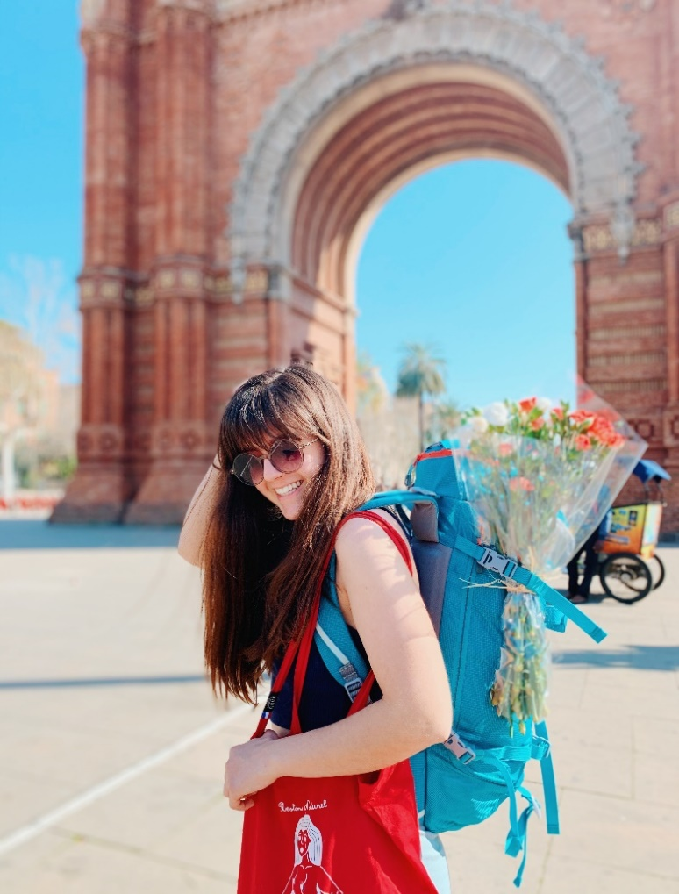
Semester Programs
Students go abroad for a full semester taking courses in their academic disciplines
Programs are offered in the fall and spring
Independent experience
Some programs cost the same as UC tuition
Toulouse, France

Slide 5
Summer Programs
Several long- and short-term summer programs
Students can take courses in their academic discipline
Can be a very affordable study abroad option
8-time study abroad participant: Chile, Hong Kong, India, South Korea, Italy, Canada, and Mexico

Slide 6
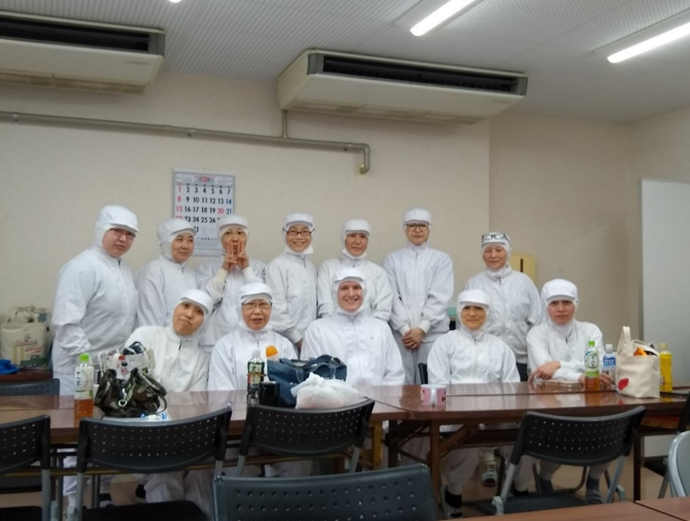
INTERNATIONAL CO-OP AND INTERNSHIPS
Students can fulfill their co-op credits abroad, if they are a co-op major
Non co-op students can take advantage of international internships through the College of Cooperative Education and Professional Studies
Available during the fall, spring, and summer semesters
Chiba, Japan

Slide 8
“Why should I study abroad?”
Fulfill major, minor and elective requirements
Build your professional network and resume
Study your major from a different perspective
Build lifelong friendships
Learn to be resilient as you navigate a new language or culture

Slide 9
Misconception: It’s too expensive
Misconception: I can only study in an English speaking country
Misconception: My major is too specific
Reality: Some programs are equal to or less than a semester at UC
Reality: Courses are taught in English in a variety of locations
Reality: Every college has opportunities abroad

Slide 10
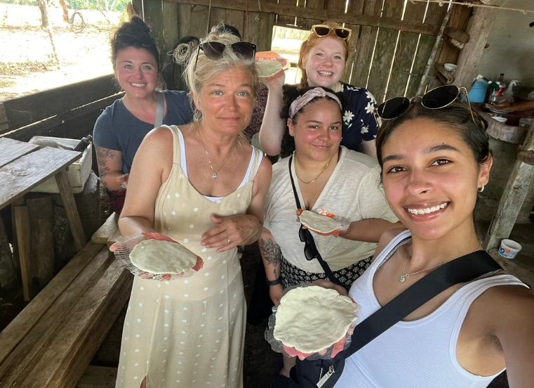
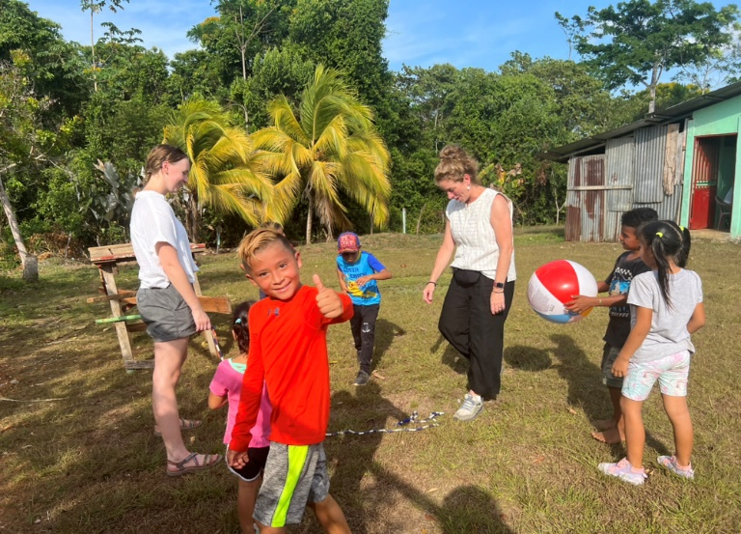
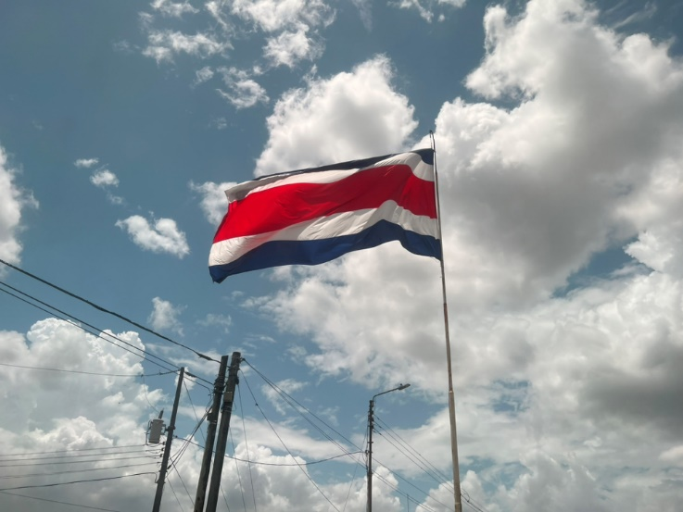
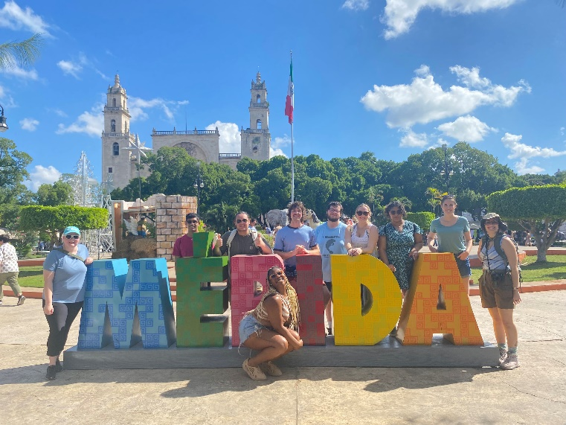
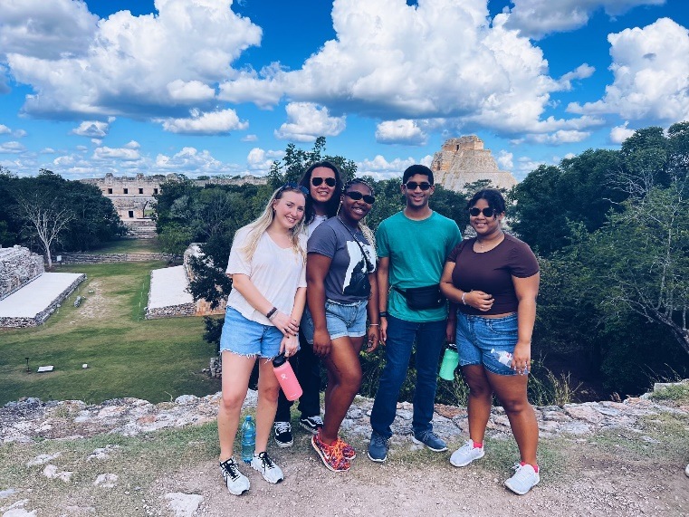
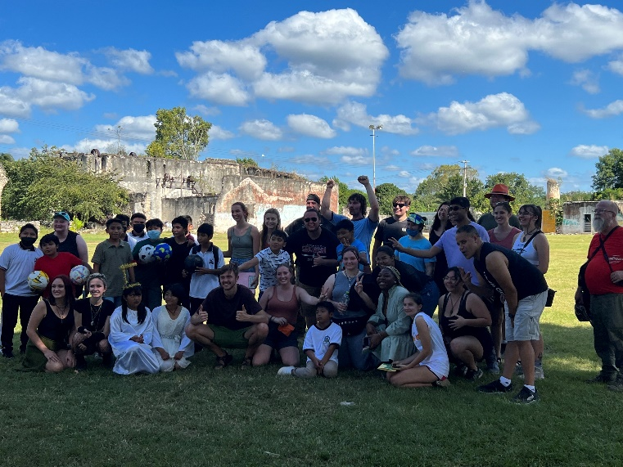
STUDENT EXPERIENCE
SW 4131 - Social Work Service Abroad
GEOG 1073 – Legacy and Landscape of the Yucatan Peninsula

Slide 11
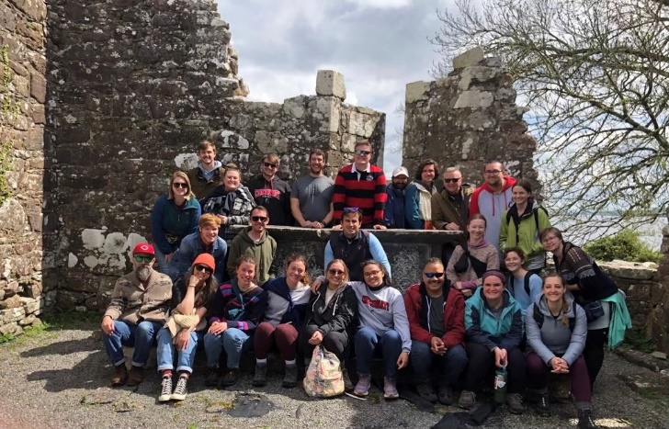
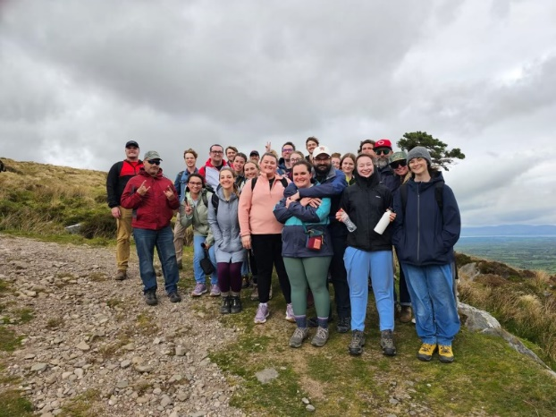
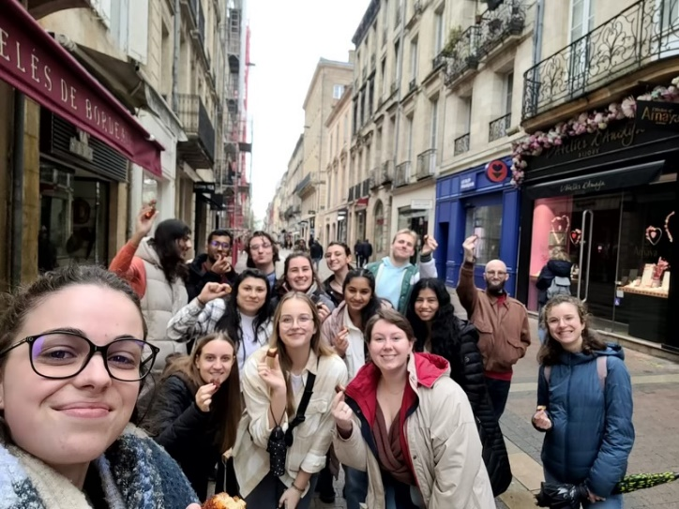
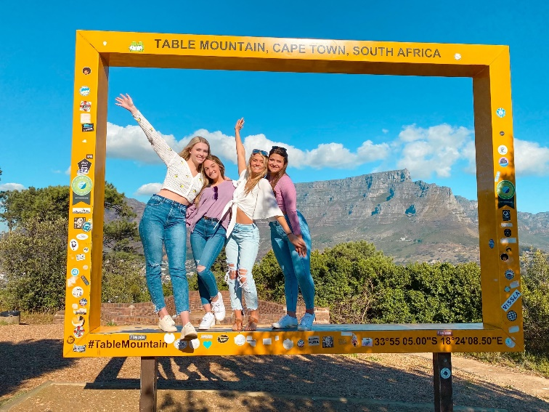
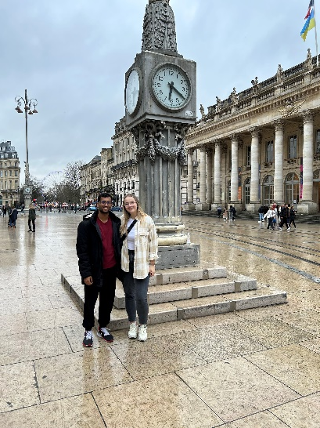
STUDENT EXPERIENCE
GEOG 5150 International Field Trips to Munster, Ireland
SPAN 3062 – Study Tour to Mexico – Queretaro, Mexico
CHEM 5021 – Science Without Borders, Bordeaux, France
INTB 3093 – Empowering Small Business Owners

Slide 12
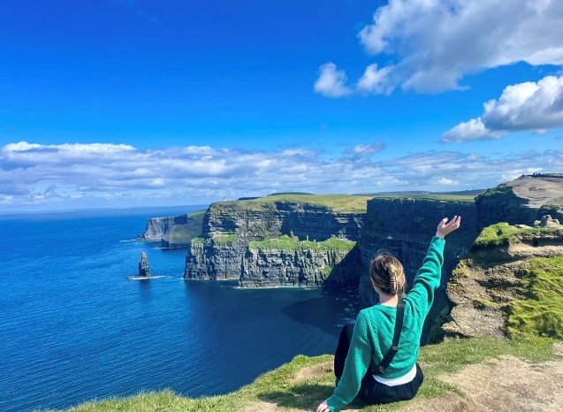
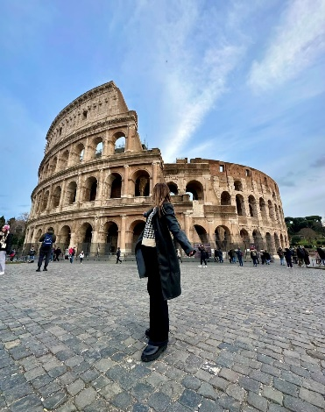
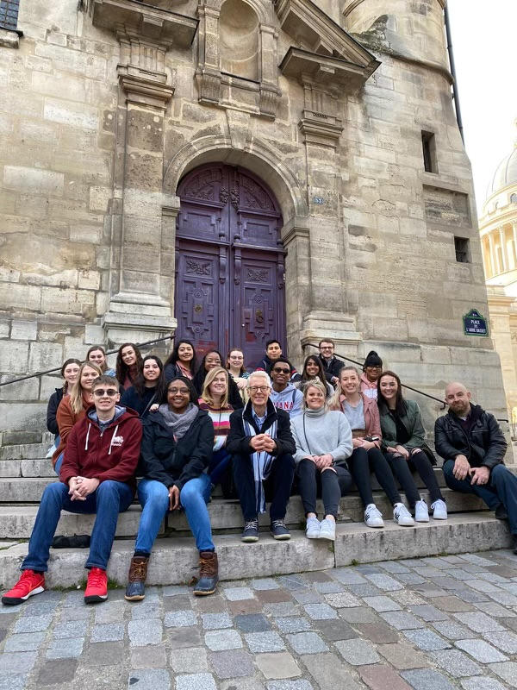
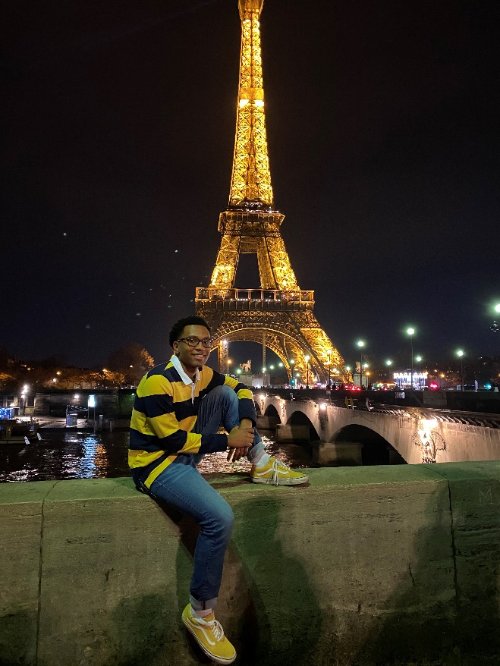
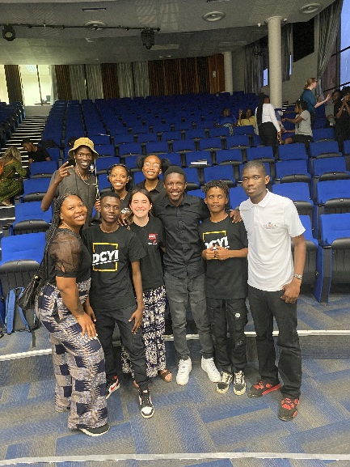
STUDENT EXPERIENCE
Spring Semester in Italy Sponsored by USAC
MEDS 3015 In the Footsteps of Louis Pasteur: Science & Art in Paris
EDST Directed Study Abroad in Botswana, Africa

Slide 13
Follow us on social media!
/ucinternational
@ucinternational
@UC_Global

Slide 14
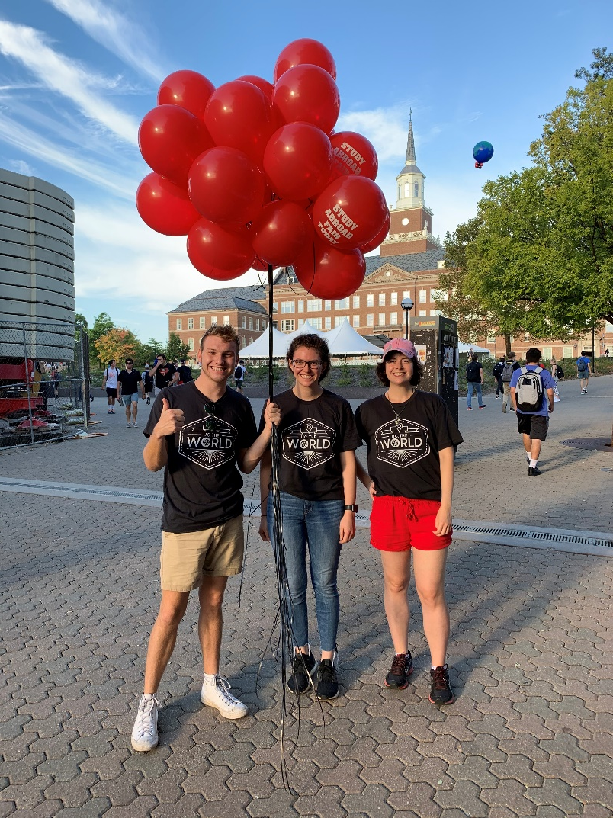
Advising/Info Session Schedule
studyabroad.uc.edu
Reach out to us
global@uc.edu

Slide 15
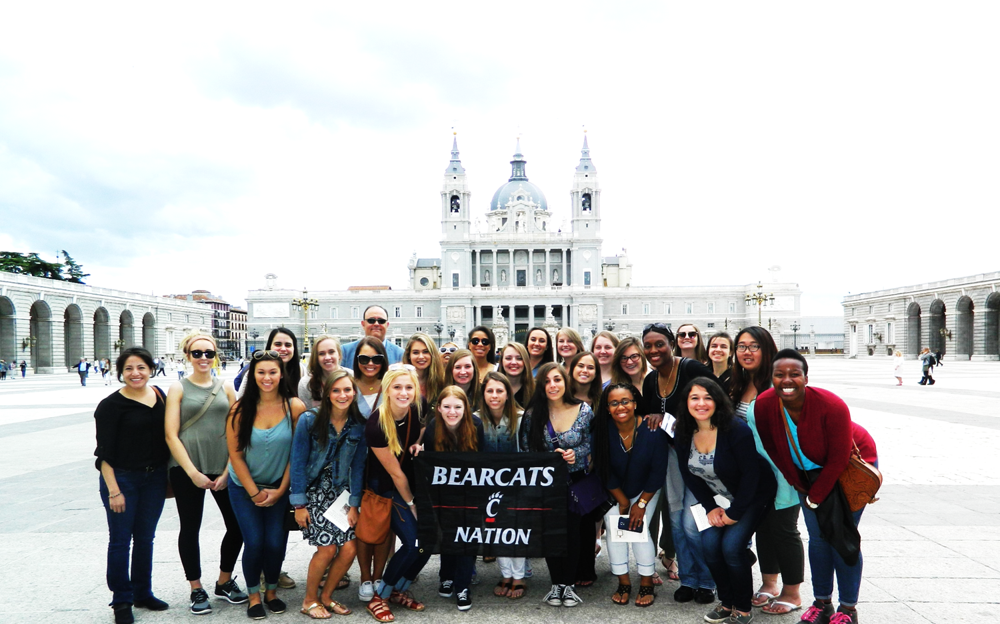
Final Picture!
studyabroad.uc.edu
Questions? Check out our table in the TUC Atrium!

Slide 16
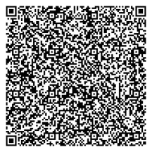
Concurrent Session Block 1
Please scan the QR code using your phone's camera to be entered into the Closing Ceremony raffle.
*must be present at Closing Ceremony to win

Slide 17
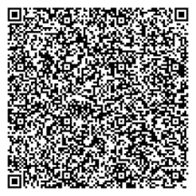
Concurrent Session Block 2
Please scan the QR code using your phone's camera to be entered into the Closing Ceremony raffle.
*must be present at Closing Ceremony to win

Slide 18
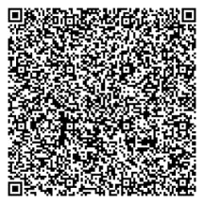
Concurrent Session Block 3
Please scan the QR code using your phone's camera to be entered into the Closing Ceremony raffle.
*must be present at Closing Ceremony to win

